Slide 1
DEVSIM TCAD Semiconductor device simulator
19/02/2025

Slide 2
agenda
Setting up (installation)
Equations and models
Meshing
Solver and Numerics
Simulating a 1-D diode with visualizations

Slide 3



Setting up
PYTHON 3.7 or higher
Anaconda (highly recommended)
Installing DEVSIM

Slide 4
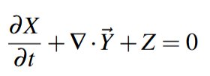
Equations and models
DEVSIM uses control volume approach for assembling PDEs on the simulation mesh. It solves the equations of the form:
Basic Terminology:
Mesh- spatial discretization of the simulation domain. Contains regions, edges and nodes
Device- discrete structure being simulated. Composed of regions, interfaces and contacts
Region- A portion of the device of a specific material. Each region has its own set of equations being solved
Interface- Connects two regions together. At the interfaces, equations are specified to account for how the flux in each device crosses the region boundary
Contact- Specifies boundary conditions required for device simulation. Also specifies how terminal currents are integrated into an external circuit
Eg: In a MOSFET, the regions would be the source, drain, and channel, with interfaces between them
Notes:
Control/finite Volume numerical technique where the computational domain is divided into small, discrete regions called "control volumes," and the PDE is integrated over each control volume to obtain a system of algebraic equations that can be solved numerically

Slide 5
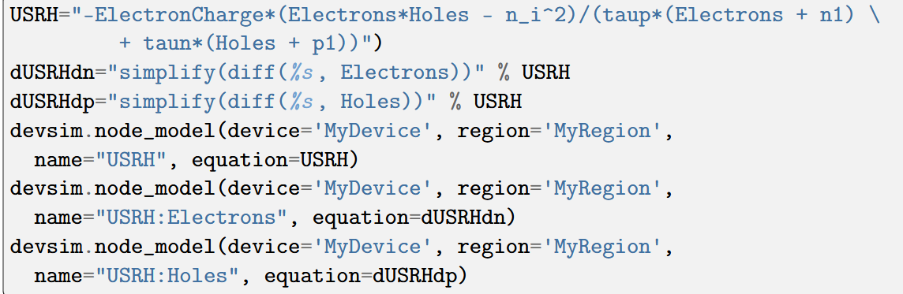
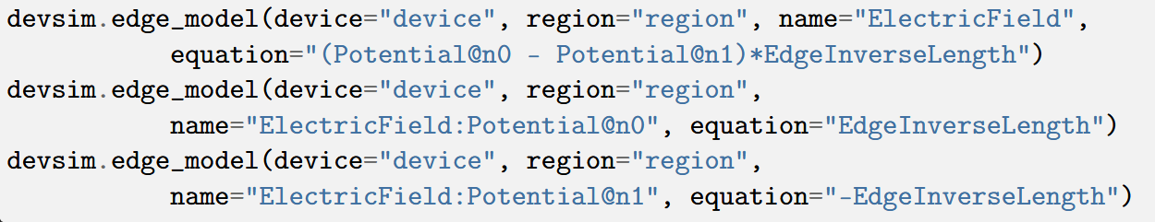
Bulk Models: Define how physical properties are modelled inside a semiconductor device.
Node models- Represents properties like carrier concentrations, potential, recombination rates, at individual nodes in a mesh.
Eg: Shockley Read Hall recombination implementation:
Edge models- Represent properties like electric field, current density, that span between two nodes.
Eg: Electric Field implementation. Note that ‘EdgeInverseLength’ is a built-in model.
Potential@n0, Potential@n1 are created using devsim.edge_from_node_model()
Derivative
Derivative
wrt n

Slide 6
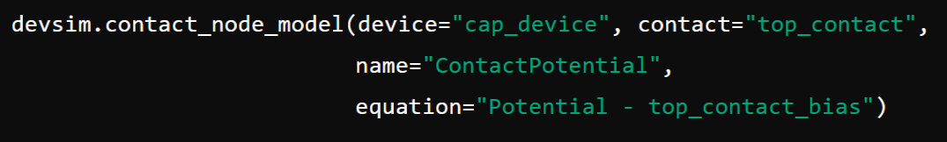
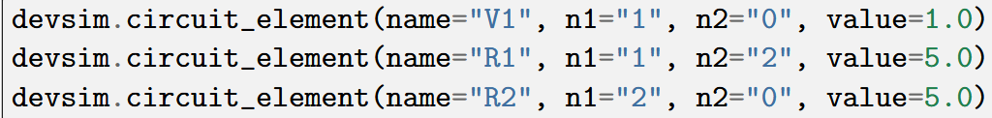
Element edge models- Used when edge quantities cannot be specified entirely in terms of the quantities on both nodes of the edge, such as when the carrier mobility is dependent on the normal electric field.
Model derivatives- To converge upon a solution, derivatives are required with respect to each of the solution variable in the system.
Equation assembly- Defines equations using bulk models
Interface models: say r0 and r1 are the regions connected by the interface:
Contact models: Defines boundary conditions for terminals
Parameters:
Circuit Elements:
Since DEVSIM uses Newton’s method, it relies on the derivatives for convergence
Notes:
Element edge- depends on something other than just the values at the two nodes.

Slide 7
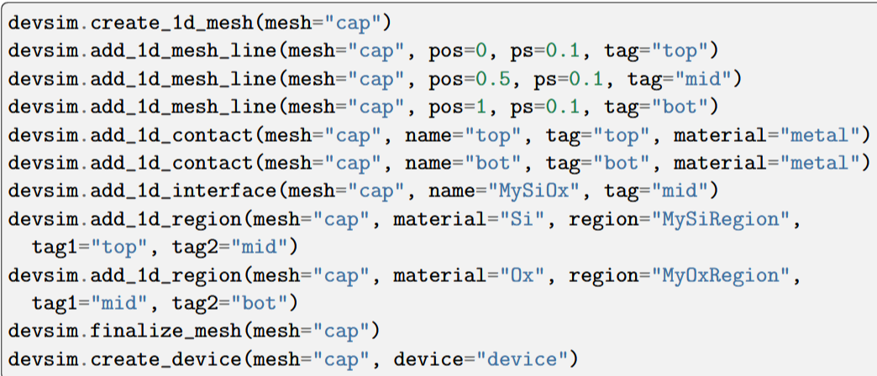
Meshing
1D-

Slide 8
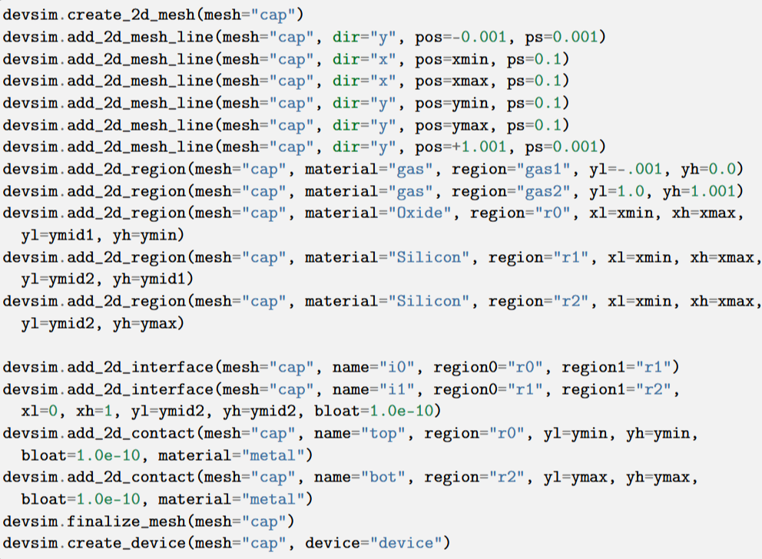
2D-
Complex meshes can also be created using an external meshing software like Gmsh and is supported by devsim.

Slide 9
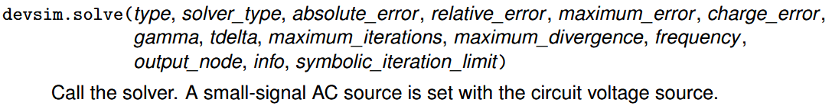
Solver and Numerics
DEVSIM uses Newton methods to solve the system of PDEs using devsim.solve()
DC analysis- for DC operating point
AC analysis- At each DC operating point, a small-signal AC analysis may be performed. An AC source is provided through a circuit and the response is then simulated

Slide 10
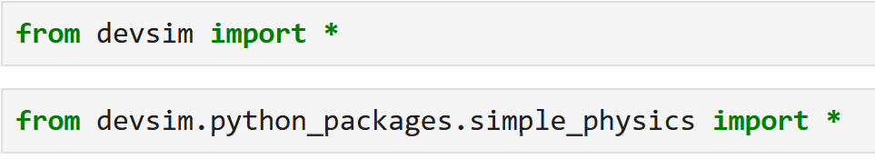

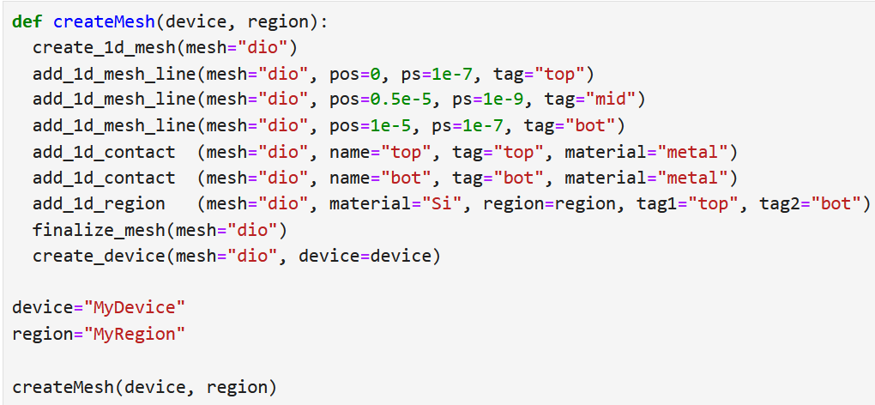
SIMULATING A 1D diode
Import necessary libraries
Creating the mesh

Slide 11
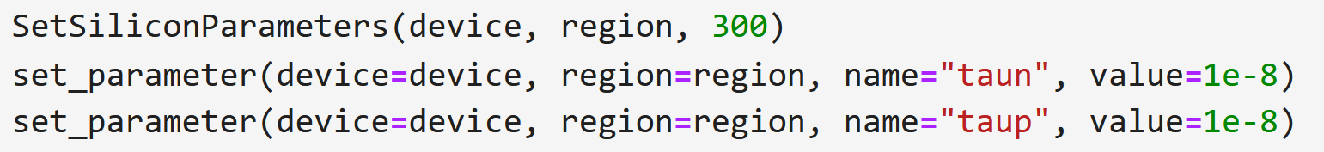
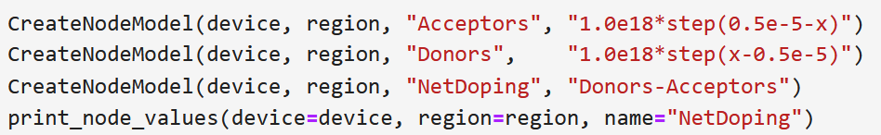
Set Parameters for 300K
Net Doping
Create Potential, Potential@n0, Potential@n1
Create potential only physical models

Slide 12
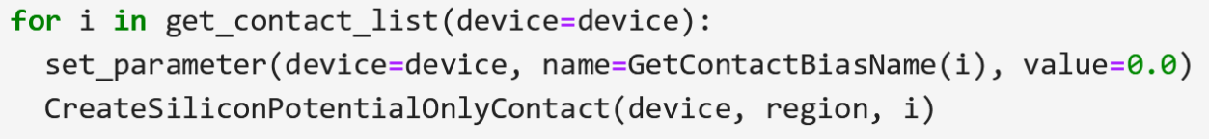
Set up contacts applying a bias
Initial DC solution

Slide 13
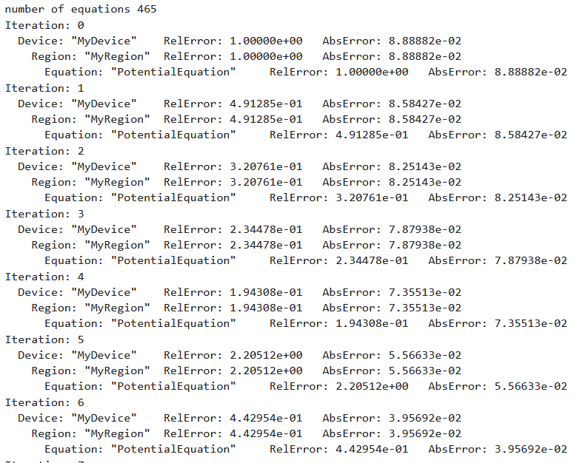
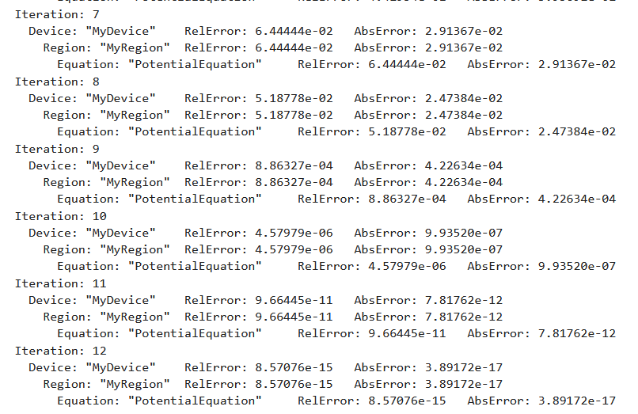

Slide 14
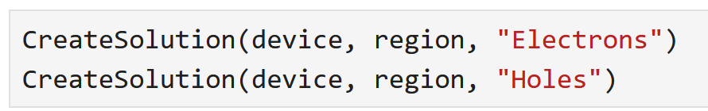
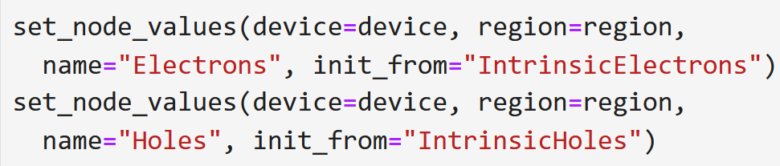

Drift diffusion solution variables
Create initial guess from DC only solution
Set up equations
Drift diffusion simulation at equilibrium

Slide 15
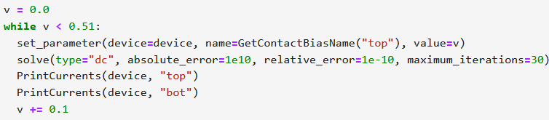
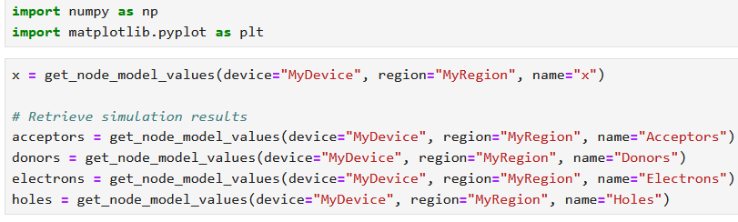
Ramp the bias to 0.5 volts
Visualize results (TecPlot 360)
Alt- Using Matplotlib

Slide 16
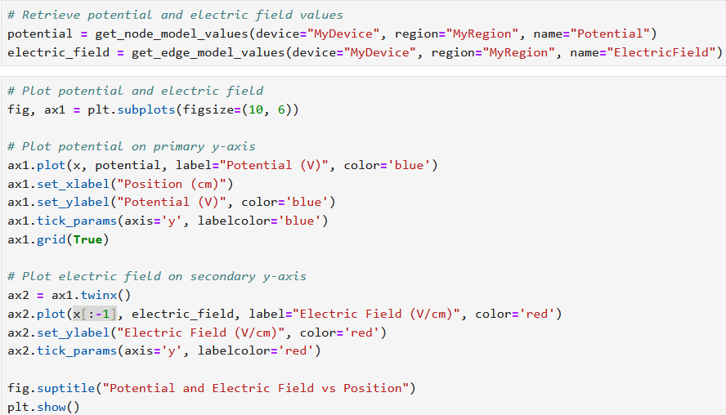
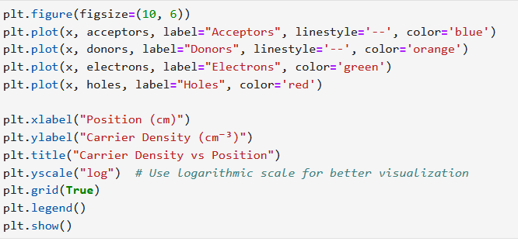
Carrier density vs position
E and V vs position

Slide 17
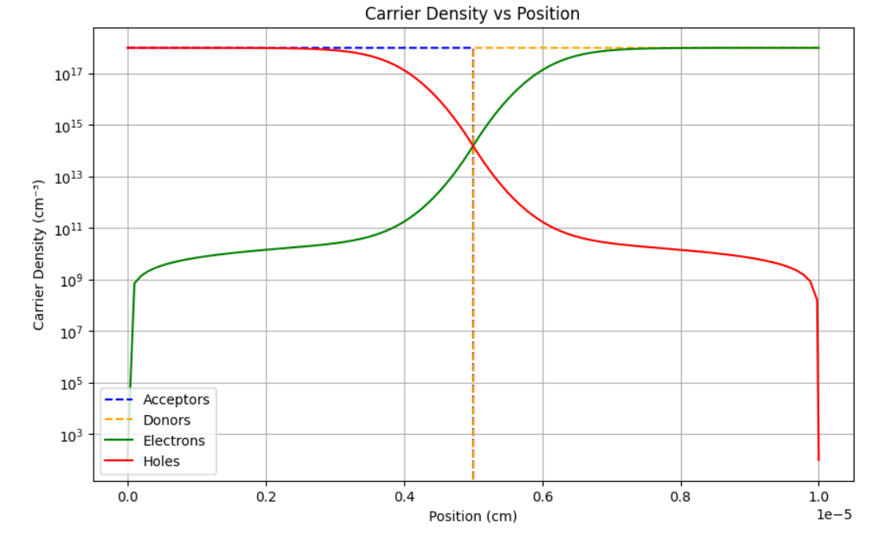

Slide 18
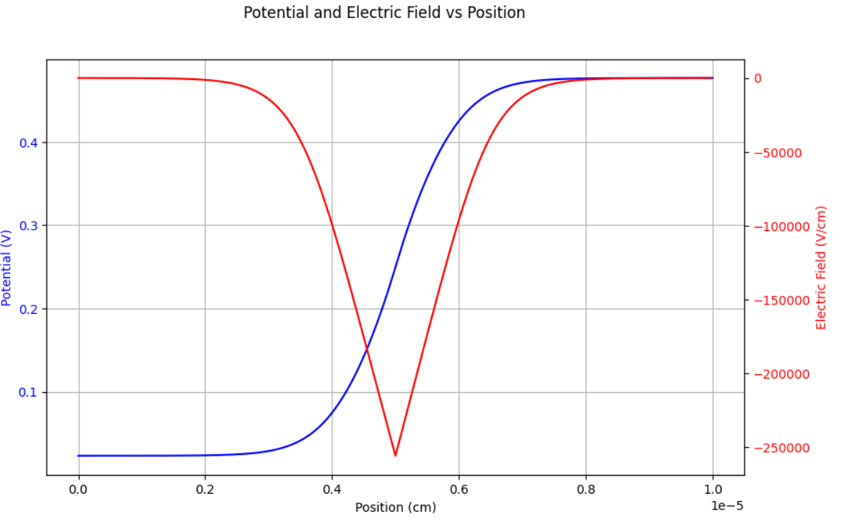

Slide 19
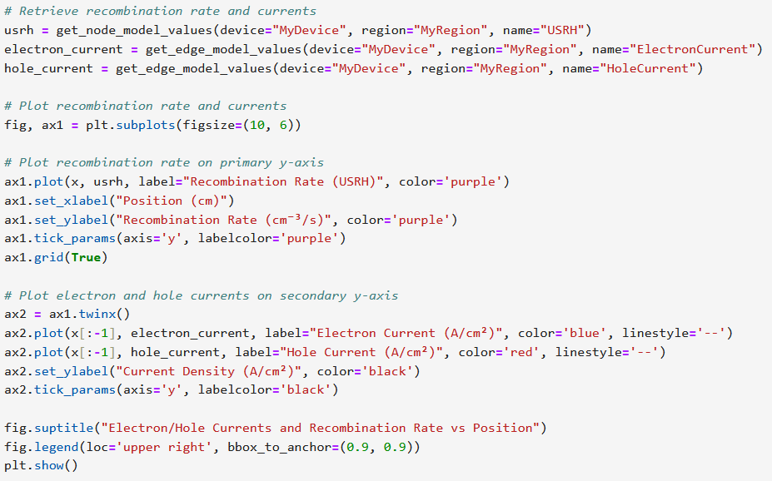
Electron and hole currents and recombination

Slide 20
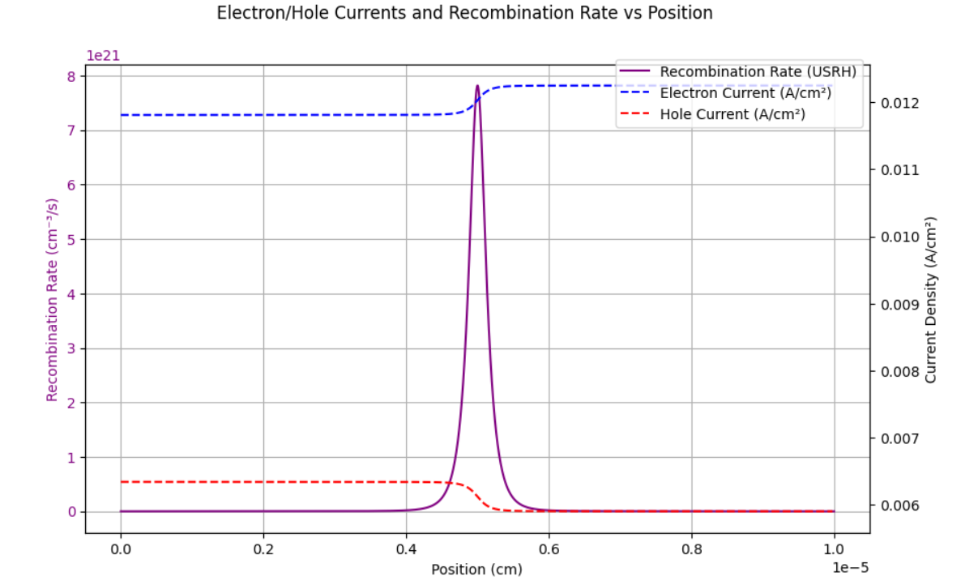

Slide 21
Summary and key takeaways

Slide 22
Thank you!
DEVSIM manual:
https://devsim.net/
Samarth Sharma
samarthsb23@iitk.ac.in

